Slide 1
Implicit User Feedback
Hongning Wang
CS@UVa

Slide 2
Explicit relevance feedback
Results:
d₁ 3.5
d₂ 2.4
…
d_{k} 0.5
...
Query
Retrieval
Engine
User
judgment
Updated
query
Document
collection
Judgments:
d₁ +
d₂ -
d₃ ₊
…
d_{k} -
...
Feedback

Slide 3
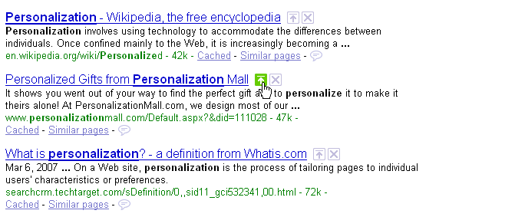
Relevance feedback in real systems
Google used to provide such functions
Vulnerable to spammers
Relevant
Nonrelevant

Slide 4
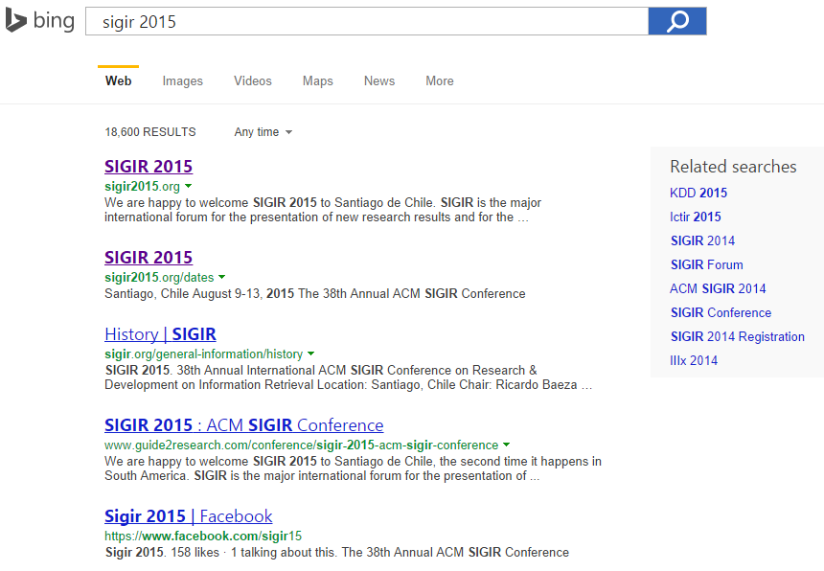
How about using clicks
Clicked document as relevant, non-clicked as non-relevant
Cheap, largely available

Slide 5
Recap: feedback as model interpolation
Document D
Results
Query Q
Key: estimate the feedback model
Feedback Docs
F={d₁, d₂ , …, d_{n}}
α=0
α=1
Generative model
No feedback
Full feedback
Q: Rocchio feedback in vector space model?
A: Very similar, but with different interpretations.

Slide 6
Recap: how to estimate θ_{F}?
the 0.2
a 0.1
we 0.01
to 0.02
…
flight 0.0001
company 0.00005
…
fixed
Feedback
Doc(s)
Known
Background
p(w|C)
λ=0.7
ML
Estimator
Unknown
query topic
p(w|θ_{F})=?
“airport security”
…
accident =?
regulation =?
passenger=?
rules =?
…
λ=0.3
Suppose, we know the identity of each word
; but we don’t...

Slide 7
Recap: Expectation Maximization algorithm
Identity (“hidden”) variable: z_{i} ∈{1 (background), 0(topic)}
z_{i}
1
1
1
1
0
0
0
1
0
...
Suppose the parameters are all known, what’s a reasonable guess of z_{i}?
- depends on λ (why?)
- depends on p(w|C) and p(w|θ_{F}) (how?)
the
paper
presents
a
text
mining
algorithm
the
paper
...
E-step
M-step
Why in Rocchio we did not distinguish a word’s identity?

Slide 8
Is click reliable?
Why do we click on the returned document?
Title/snippet looks attractive
We haven’t read the full text content of the document
It was ranked higher
Belief bias towards ranking
We know it is the answer!

Slide 9

Is click reliable?
Why do not we click on the returned document?
Title/snippet has already provided the answer
Instant answers, knowledge graph
Extra effort of scrolling down the result page
The expected loss is larger than skipping the document
We did not see it….
Can we trust click as relevance feedback?

Slide 10
Accurately Interpreting Clickthrough Data as Implicit Feedback ^{[Joachims SIGIR’05]}
Eye tracking, click and manual relevance judgment to answer
Do users scan the results from top to bottom?
How many abstracts do they read before clicking?
How does their behavior change, if search results are artificially manipulated?

Slide 11
Which links do users view and click?
Positional bias
Fixations: a spatially stable gaze lasting for approximately 200-300 ms, indicating visual attention
First 5 results are visible without scrolling

Slide 12
Do users scan links from top to bottom?
Need scroll down to view these results
View the top two results within the second or third fixation

Slide 13
Which links do users evaluate before clicking?
The lower the click in the ranking, the more abstracts are viewed before the click

Slide 14
Does relevance influence user decisions?
Controlled relevance quality
Reverse the ranking from search engine
Users’ reactions
Scan significantly more abstracts than before
Less likely to click on the first result
Average clicked rank position drops from 2.66 to 4.03
Average clicks per query drops from 0.8 to 0.64

Slide 15
Are clicks absolute relevance judgments?
Position bias
Focus on position one and two, equally likely to be viewed

Slide 16
Are clicks relative relevance judgments?
Clicks as pairwise preference statements
Given a ranked list and user clicks
Click > Skip Above
Last Click > Skip Above
Click > Earlier Click
Last Click > Skip Previous
Click > Skip Next
(2)
(1)
(3)

Slide 17
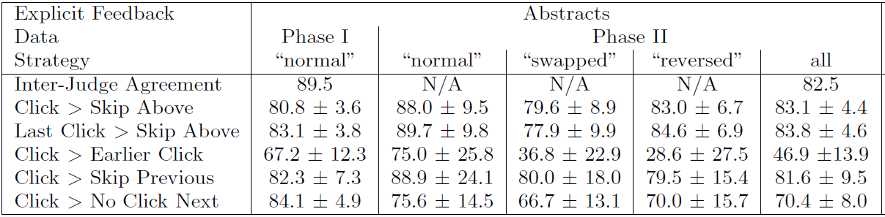
Clicks as pairwise preference statements
Accuracy against manual relevance judgment over abstract

Slide 18
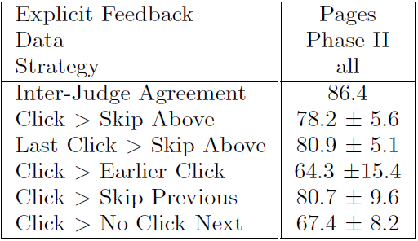
How accurately do clicks correspond to explicit judgment of a document?
Accuracy against manual relevance judgment

Slide 19
What do we get from this user study?
Clicks are influenced by the relevance of results
Biased by the trust over rank positions
Clicks as relative preference statement is more accurate
Several heuristics to generate the preference pairs

Slide 20
How to utilize such preference pairs?
Pairwise learning to rank algorithms
Will be covered later

Slide 21
Recap: Accurately Interpreting Clickthrough Data as Implicit Feedback
Eye tracking, click and manual relevance judgment to answer
Do users scan the results from top to bottom?
How many abstracts do they read before clicking?
How does their behavior change, if search results are artificially manipulated?

Slide 22
Recap: which links do users view and click?
Positional bias
Fixations: a spatially stable gaze lasting for approximately 200-300 ms, indicating visual attention
First 5 results are visible without scrolling

Slide 23
Recap: are clicks relative relevance judgments?
Clicks as pairwise preference statements
Given a ranked list and user clicks
Click > Skip Above
Last Click > Skip Above
Click > Earlier Click
Last Click > Skip Previous
Click > Skip Next
(2)
(1)
(3)

Slide 24
Recap: clicks as pairwise preference statements
Accuracy against manual relevance judgment over abstract

Slide 25
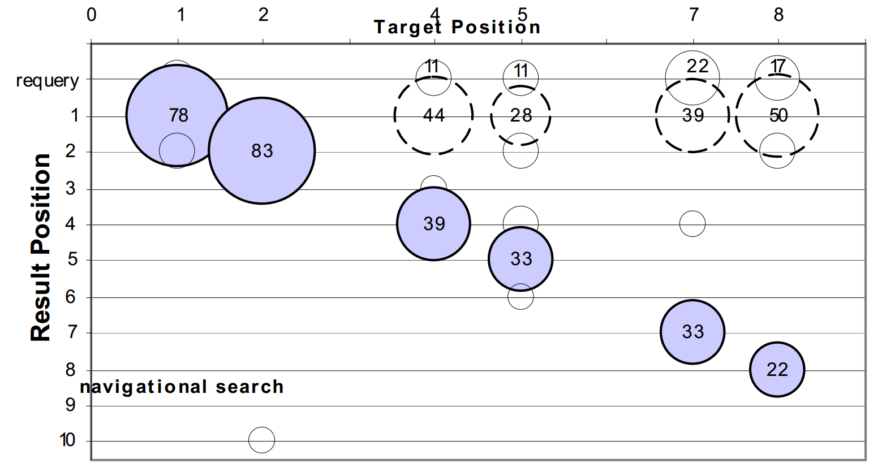
An eye tracking study of the effect of target rank on web search ^{[Guan CHI’07]}
Break down of users’ click accuracy
Navigational search
First result

Slide 26
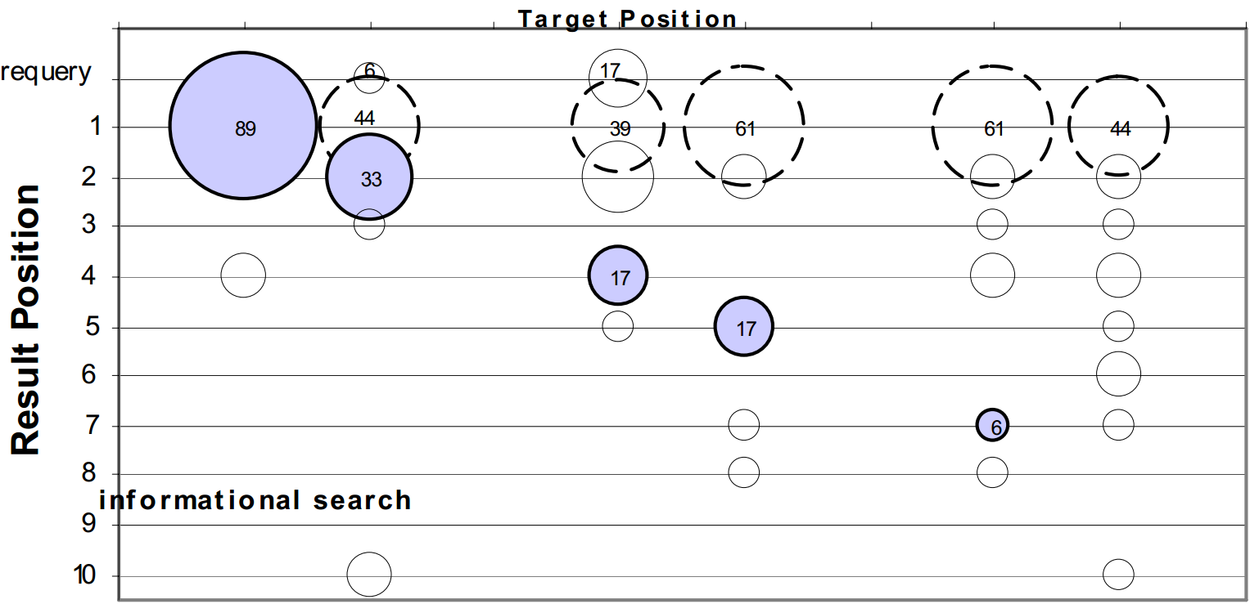
An eye tracking study of the effect of target rank on web search ^{[Guan CHI’07]}
Break down of users’ click accuracy
Informational search
First result

Slide 27
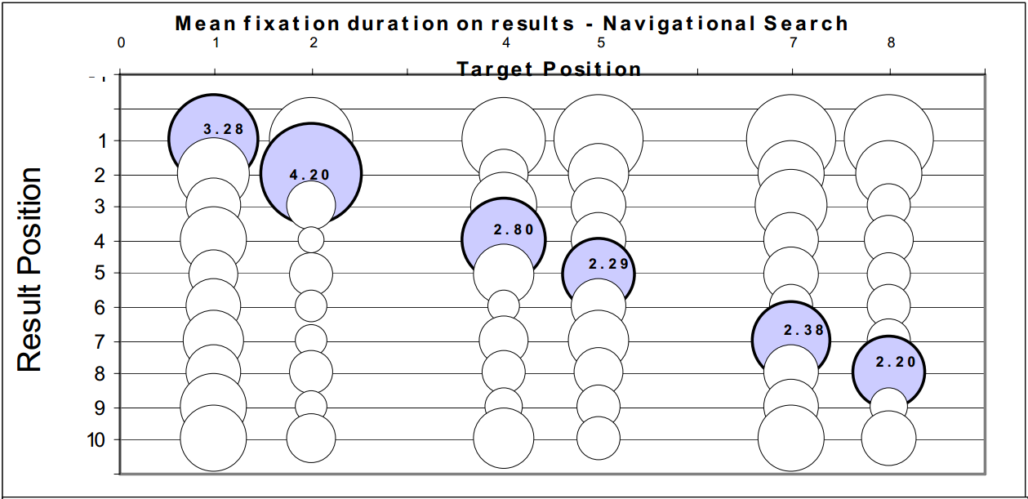
Users failed to recognize the target because they did not read it!
Navigational search

Slide 28
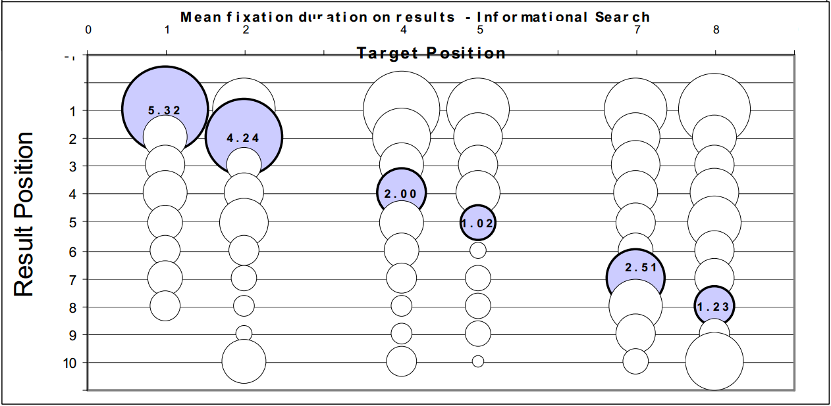
Users did not click because they did not read the results!
Informational search

Slide 29
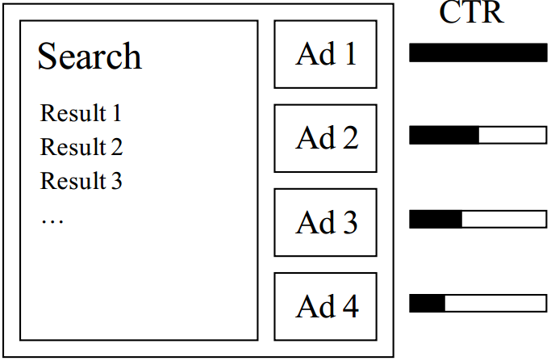
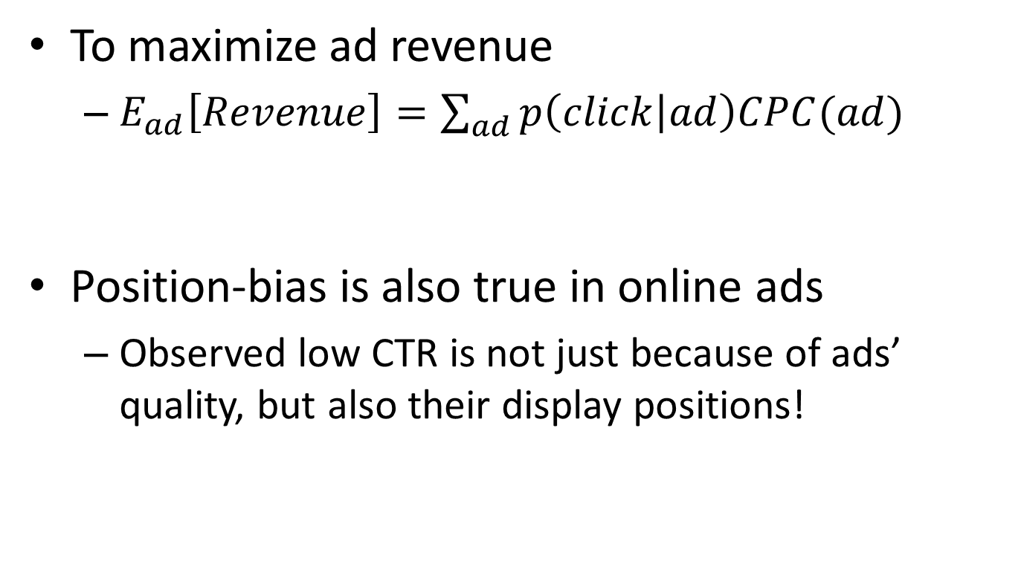
Predicting clicks: estimating the click-through rate for new ads ^{[Richardson WWW’07]}
To maximize ad revenue
$E_{ad}\left[Revenue\right]=\sum_{ad}{p\left(click | ad\right)CPC(ad)}$
Position-bias is also true in online ads
Observed low CTR is not just because of ads’ quality, but also their display positions!
Cost per click: basic business model in search engines
Estimated click-through rate

Slide 30

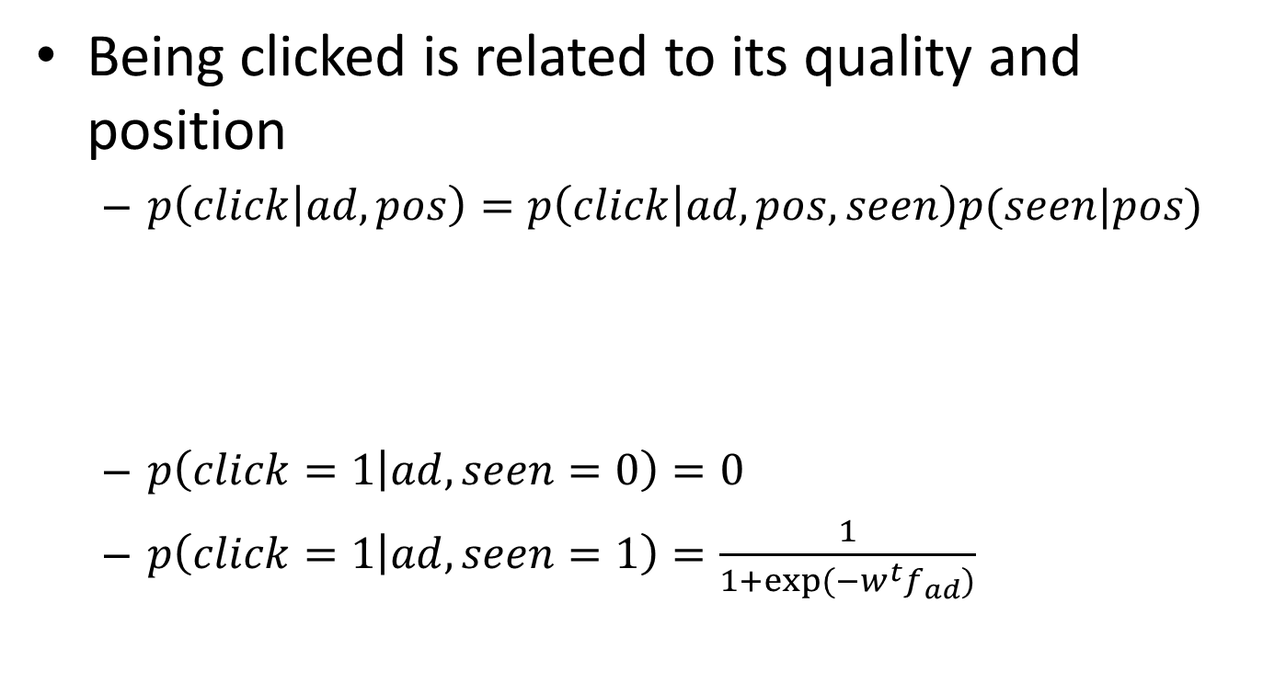
Combat position-bias by explicitly modeling it
Being clicked is related to its quality and position
$p\left(click | ad,pos\right)=p\left(click | ad,pos,seen\right)p(seen|pos)$
$p\left(click=1 | ad,seen=0\right)=0$
$p\left(click=1 | ad,seen=1\right)=\frac{1}{1+exp⁡(−w^{t}f_{ad})}$
$$=p\left(click | ad,seen\right)p(seen|pos)$$
Calibrated CTR for ads ranking
Discounting factor
Logistic regression by features of the ad

Slide 31
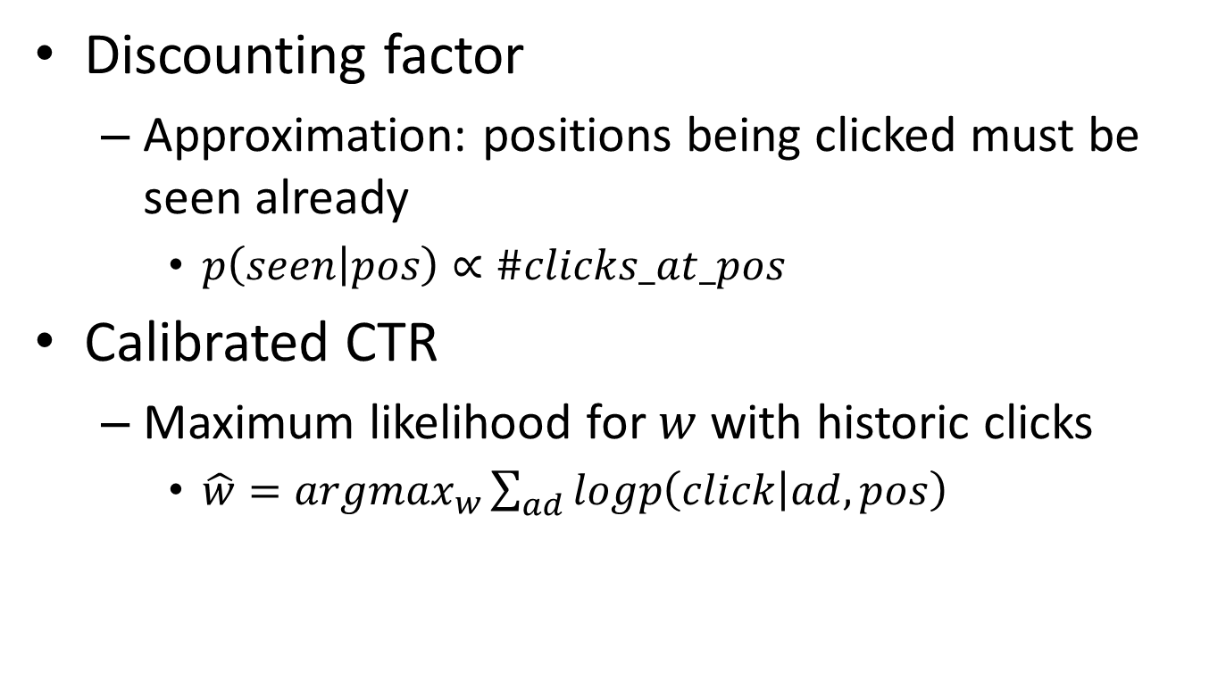
Parameter estimation
Discounting factor
Approximation: positions being clicked must be seen already
$p\left(seen | pos\right)∝\#clicks_at_pos$
Calibrated CTR
Maximum likelihood for $w$ with historic clicks
$\hat{w}=argmax_{w}\sum_{ad}{logp\left(click | ad,pos\right)}$

Slide 32
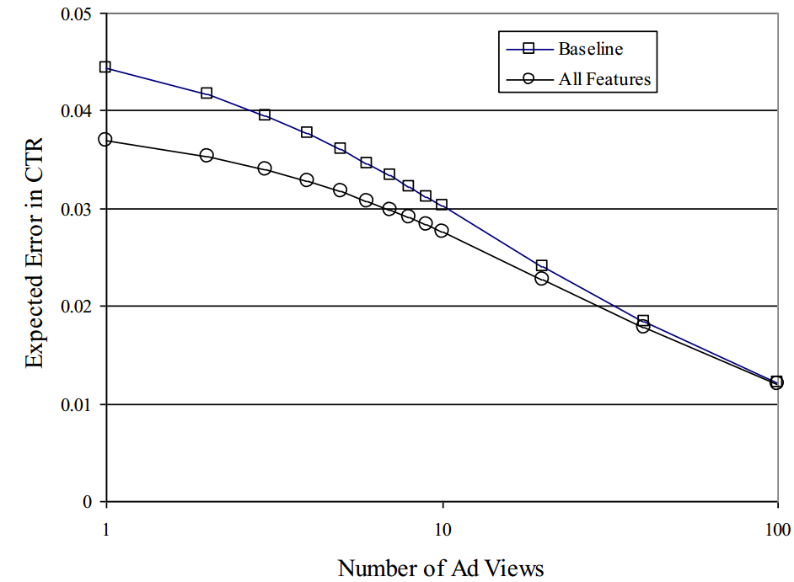
Calibrated CTR is more accurate for new ads
Simple counting of CTR
Unfortunately, their evaluation criterion is still based on biased clicks in testing set

Slide 33
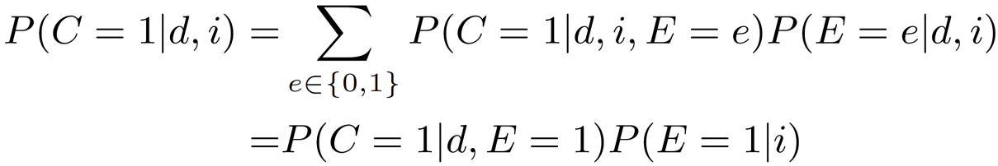
Click models
Decompose relevance-driven clicks from position-driven clicks
Examine: user reads the displayed result
Click: user clicks on the displayed result
Atomic unit: (query, doc)
Prob.
(q,d₁)
(q,d₂)
Relevance quality
Pos.
Click probability
Examine probability
(q,d₃)
(q,d₄)
Notes:
A user clicks on a returned document if and only if that document has been examined by the user and it is relevant to the given query.

Slide 34
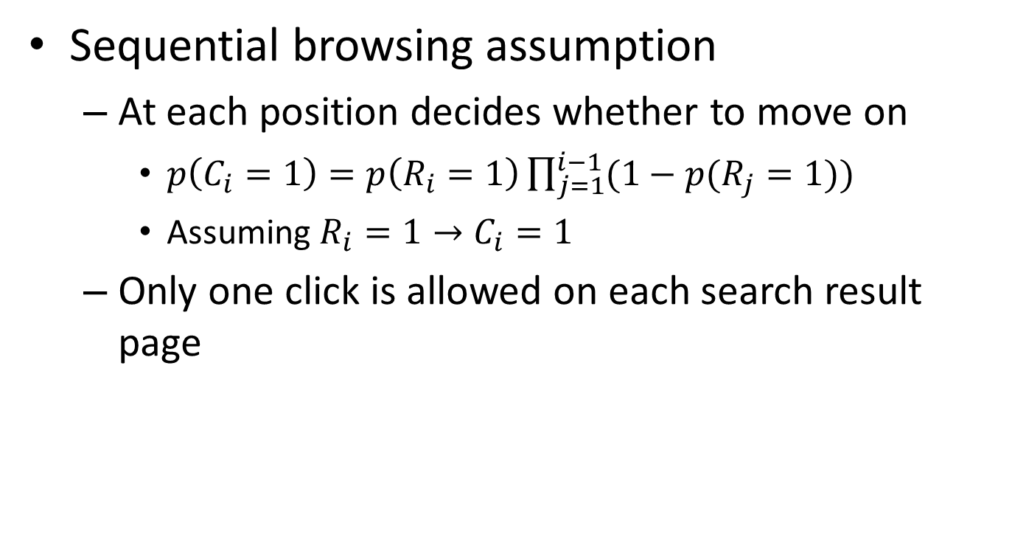
Cascade Model ^{[Craswell et al. WSDM’08]}
Sequential browsing assumption
At each position decides whether to move on
$p\left(C_{i}=1\right)=p\left(R_{i}=1\right)\prod_{j=1}^{i−1}{(1−p(R_{j}=1))}$
Assuming $R_{i}=1→C_{i}=1$
Only one click is allowed on each search result page
Kind of “Click > Skip Above”?

Slide 35
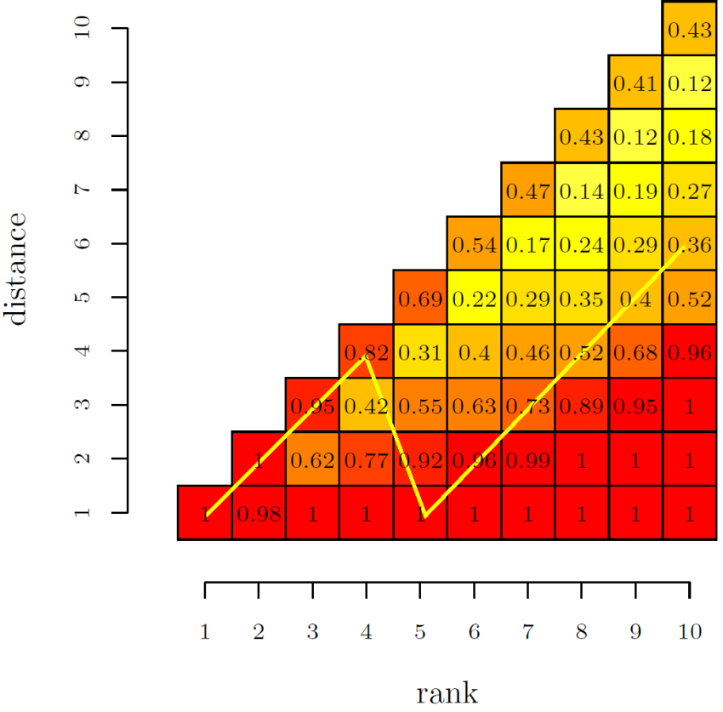
User Browsing Model ^{[Dupret et al. SIGIR’08]}
Examination depends on distance to the last click
Attractiveness, determined by query and URL
Examination, determined by position and distance to last click
EM for parameter estimation
From absolute discount to relative discount
Kind of “Click > Skip Next”
+ “Click > Skip Above”?

Slide 36
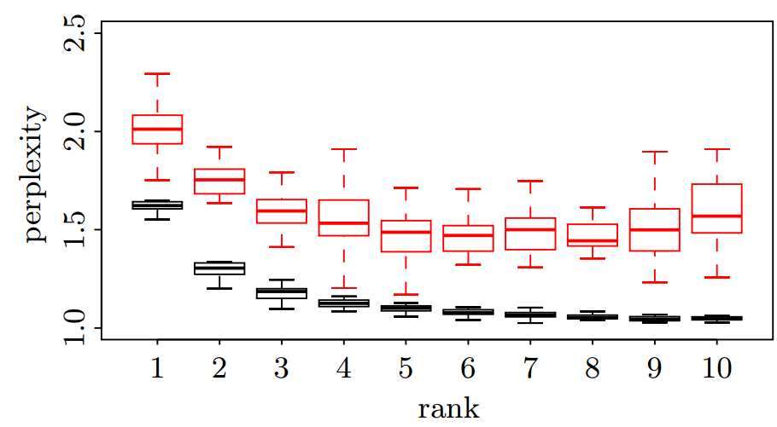
More accurate prediction of clicks
Perplexity – randomness of prediction
Cascade model
Browsing model

Slide 37
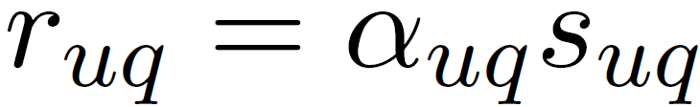




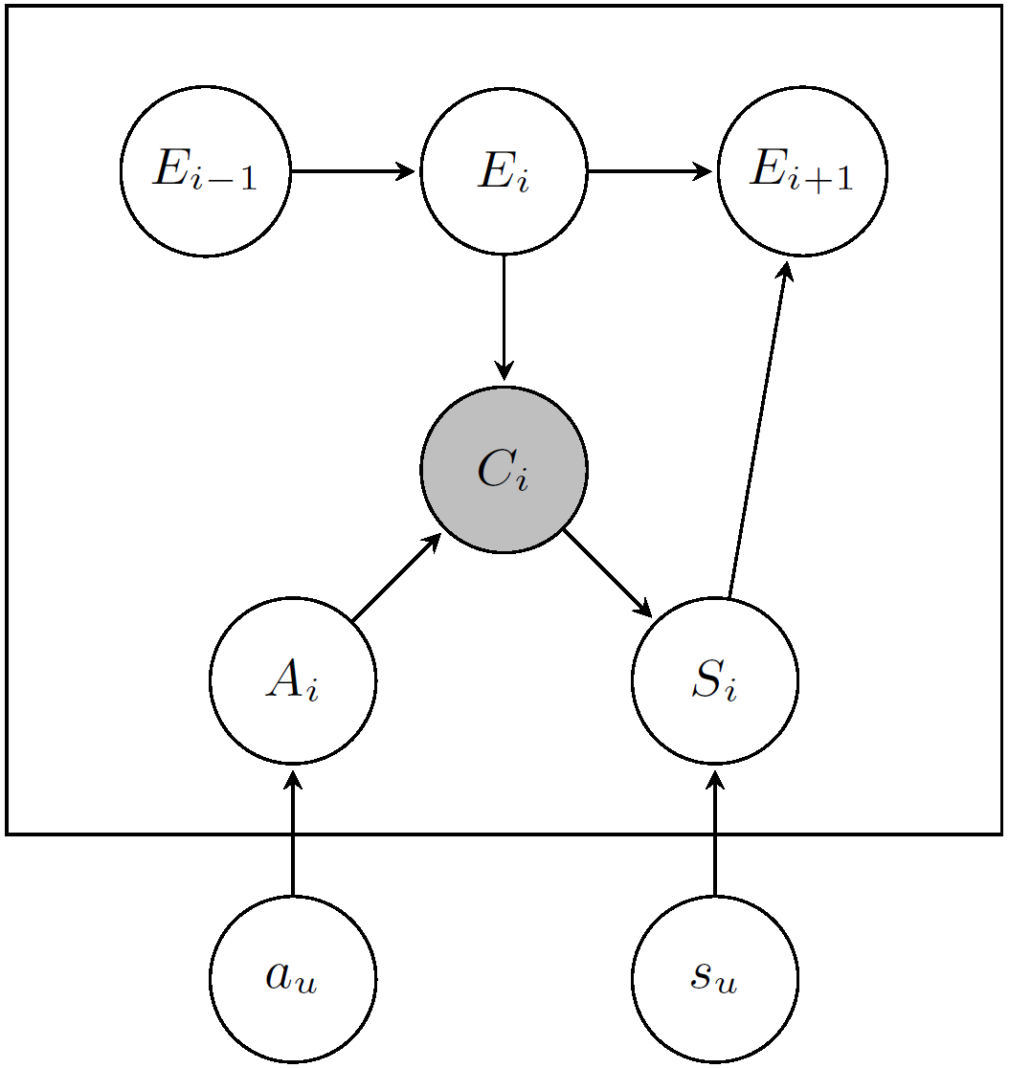
Dynamic Bayesian Model ^{[Chapelle et al. WWW’09]}
A cascade model
Relevance quality:
User’s satisfaction
Examination chain
Perceived relevance
Intrinsic relevance
Notes:
Cascade model assumes the user will examine the returned documents from top to bottom and make click decisions over each examined position sequentially.
Imposing stronger dependency assumption over the user’s click behaviors
Perceived relevance controls click and intrinsic relevance controls user’s satisfaction.

Slide 38
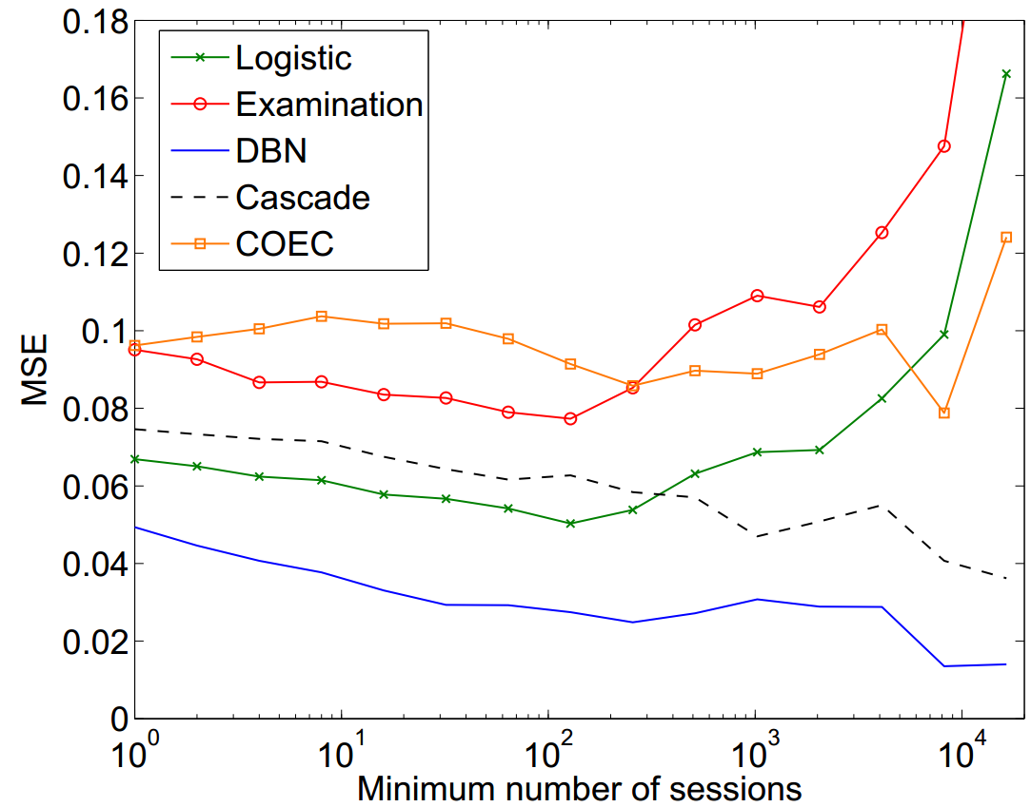
Accuracy in predicting CTR

Slide 39
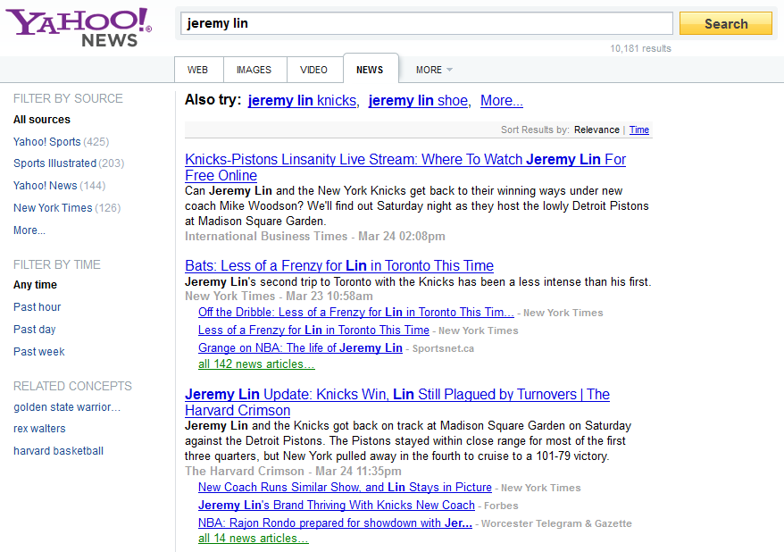

Revisit User Click Behaviors
Match my query?
Redundant doc?
Shall I move on?

Slide 40
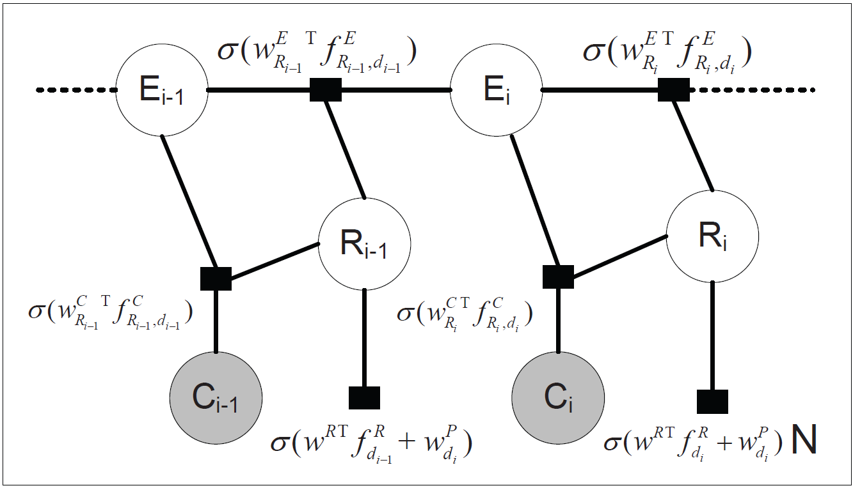
Content-Aware Click Modeling ^{[Wang et al. WWW’12]}
Encode dependency within user browsing behaviors via descriptive features
Chance to further examine the result documents: e.g., position, # clicks, distance to last click
Chance to click on an examined and relevant document: e.g., clicked/skipped content similarity
Relevance quality of a document: e.g., ranking features

Slide 41
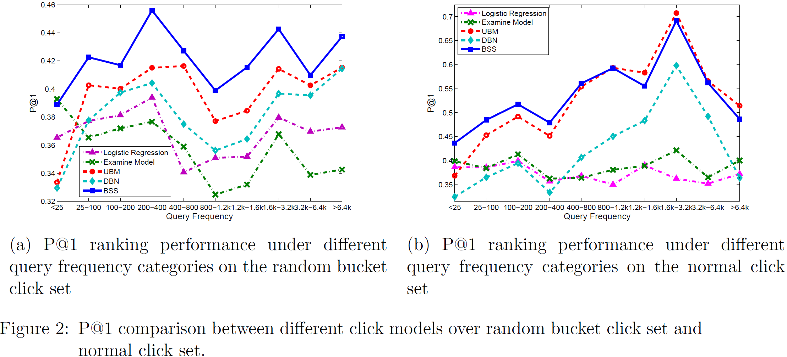
Quality of relevance modeling
Estimated relevance for ranking

Slide 42
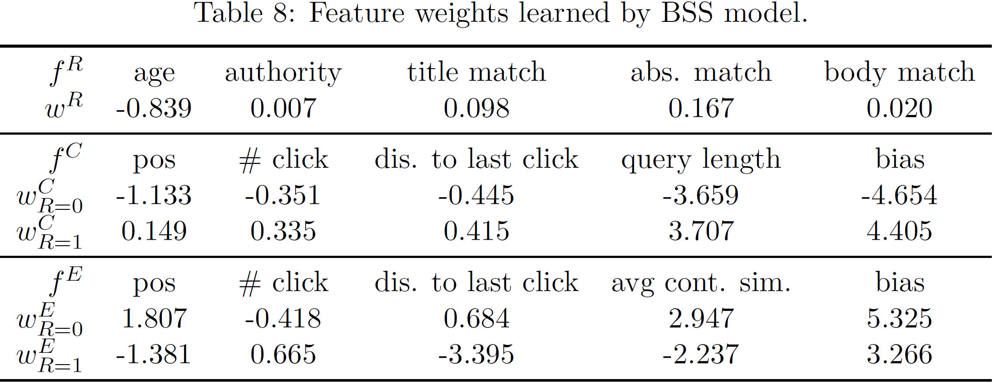
Understanding user behaviors
Analyzing factors affecting user clicks

Slide 43
What you should know
Clicks as implicit relevance feedback
Positional bias
Heuristics for generating pairwise preferences
Assumptions and modeling approaches for click models

Slide 44


